Slide 1
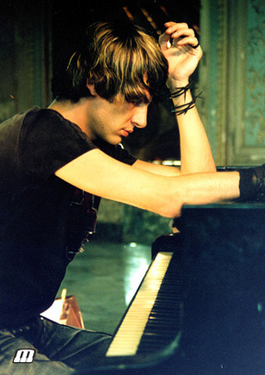
Maksim Mrvica
Worldwide famous pianist with origins from Šibenik

Slide 2
Why is he so special?
He plays classical crossover music
He covered famous pianists like Chopin and Tchaikovski in modern way
He started to play piano at age of nine and showed big talent

Slide 3
About his career:
After his 1991’s album debut album, musician, author and manager Tonči Huljić noticed Mrvica’s work and got him in touch with British Mel Bush, who just have been looking for a new pianist. He made new record named The Piano Player, where he played Chopin and Handel in different way than usual. He is very popular in Asian countries like China, Malaysia and Singapore.

Slide 4
Discography:
1999 – Gestures
2003 – The Piano Player
2004 – Variations I & II
2005 – A New World
2006 – Electric
2007 – Pure
2008 – Pure II
2008 – Greatest Maksim
2010 – Appasionata
2012 – The Movies

Slide 5
Mrvica’s music videos:
The Gypsy Maid
New World Concerto
Somewhere In Time
Nostradamus
Exodus
Olympic Dream
The Flight Of Bumble Bee
Prelude In C
Anthem, Habanera
Child in Paradise
The Godfather

Slide 6
Some of Mrvica’s covers by famous artists:
Revolutionary Etude (originally by Chopin)
The Flight Of Bumblee Bee (originally by Tchaikovsky)
Bohemiam Rhapsody (originally by Queen)
Piano Concert In A Minor (originally by Grieg)
Sarabande (originally by Handel)
The Godfather Theme

Slide 7
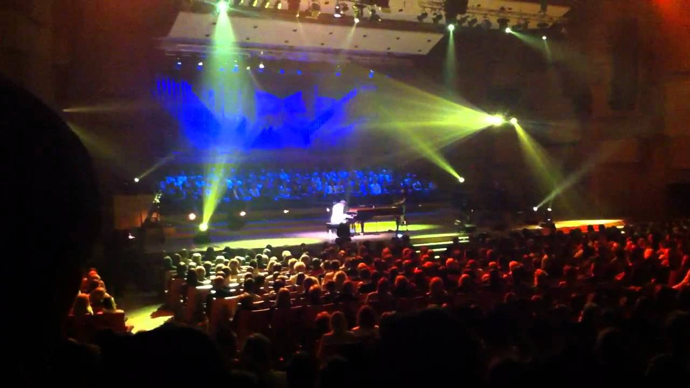
Mrvica's performances generally take place against a backdrop of special lighting, stage and video effects

Slide 8
Awards:
Maksim got a lot of awards before he even started his career of professional pianist
He got ‘’Porin’’ award for best album in cathegory of classical music in 2002 (album Gestures)

Slide 9
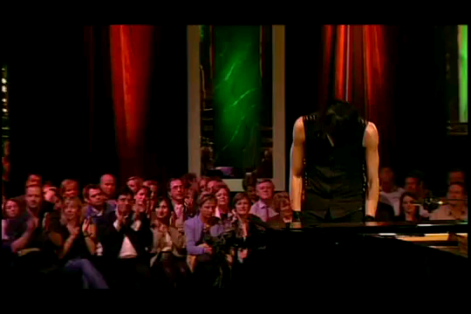
Maksim performing Chopin’s Revolutionary Etude

Slide 10
Made by: Petra Baranović Background music until 10th slide: Maksim Mrvica - Exodus

